Slide 1
Advanced Technology
Higher Education
Network Alliance

Slide 2
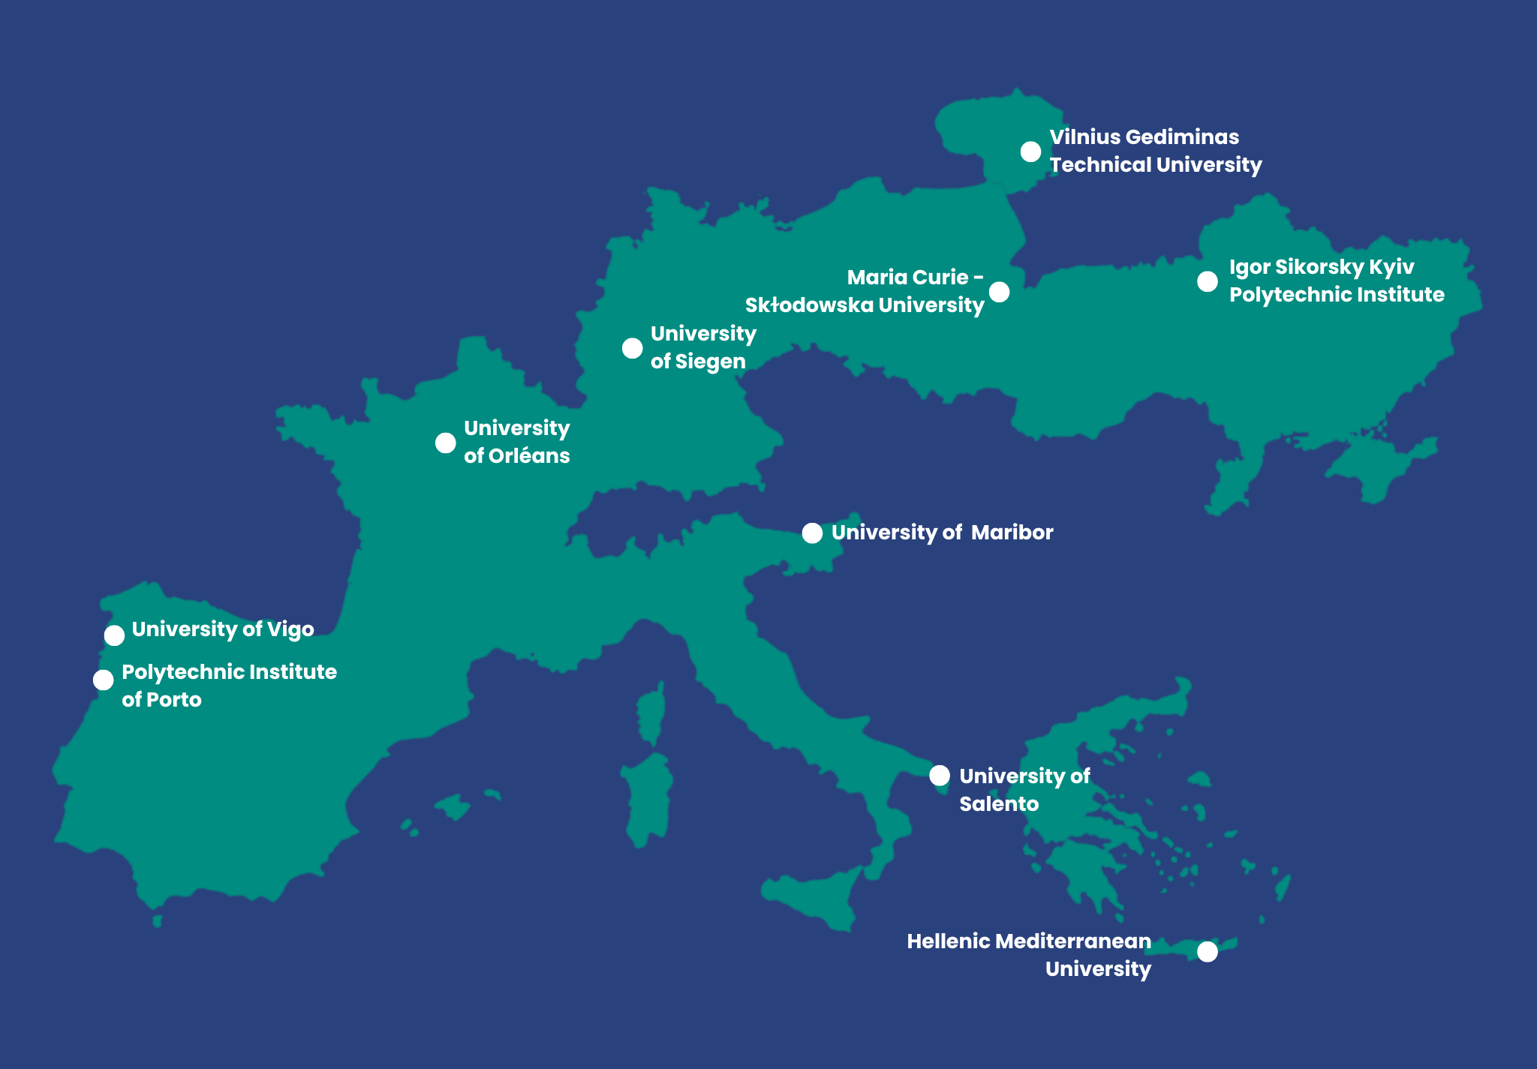
ATHENA European University is an alliance of 10 HEIs in Europe

Slide 3
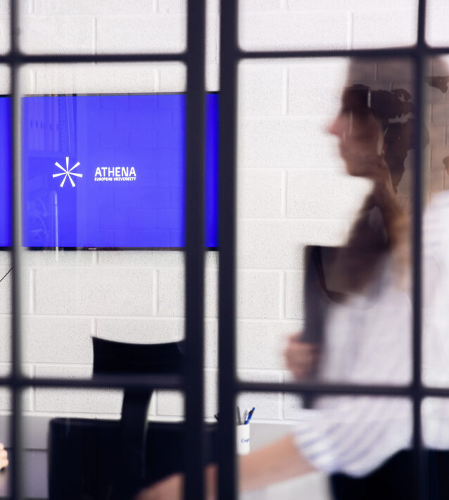
ATHENA PARTNERS
Hellenic Mediterranean University (Greece)​
Igor Sikorsky Kyiv Polytechnic Institute (Ukraine)
Maria Curie-Skłodowska University (Poland)​
Polytechnic Institute of Porto (Portugal)​
University of Maribor (Slovenia)​
University of Orléans (France)​
University of Salento (Italy)
University of Siegen (Germany)​
University of Vigo (Spain)​
Vilnius Gediminas Technical University (Lithuania)

Slide 4

1 alliance​
10 campuses​
160 000 students​
15 000 staff​
51 associated partners in industry, government & non-government institutions, public institutions

Slide 5


ATHENA aims to shape the digital transformation of society to support the development
of an inclusive, sustainable & secure digital economy

Slide 6

Common objective
Delivering high-quality education with a positive impact on research, youth employability and social advancement at the national and European levels

Slide 7

Our approach: networking with the networks!
ATHENA associate partners:​
RUFORUM association of 157 universities in Africa​
CONIF – Association of federal higher education institutions
with 41 institutions in Brazil

Slide 8
Why ATHENA?​

Slide 9
“The ATHENA educational model opens the doors of higher education institutions.”

Slide 10


WHY ATHENA?
ATHENA educational hallmarks include students’ employability, the integration of education & research, equity & inclusion, democratic values, smooth transition from education to work, entrepreneurial mindset

Slide 11
ATHENA OPPORTUNITIES

Slide 12
ATHENA FOR STUDENTS (I)
01
02
03
04
Studying in international environment
Physical, virtual & blended mobility
Individual, flexible & international learning path:​
ATHENA Competence Clusters​
BIPs​
COILs
Integrated Moodle platform & ATHENA OpenCourseWare​
ATHENA network of hybrid classes​
04
05
06
07
08
Development of soft & foreign language skills​
Early-stage researcher’s path
​
ATHENA ESN student board​
Annual ATHENATHON – community on the move​
Annual online ATHENA Career Day

Slide 13

ATHENA FOR STUDENTS (II)
09
10
11
12
13
14
9 Education Clusters ​
15+ Blended Intensive Programmes (BIP) & annual BlendEd programme​
4 Intensive Challenge-based Courses
​
Joint MSc in Embedded Intelligence
Nanosystems Engineering – from Nanoscale Technologies to Ubiquitous Smart Sensors ​
New Erasmus+ KA2 funded projects​
50+ ATHENA Talks – access to experts & expertise

Slide 14

ATHENA FOR RESEARCHERS, TEACHERS & ADMINISTRATORS
01
02
03
04
05
06
ATHENA Shared Resources Directory​
ATHENA research book – Research
publications​
Training academy​
ATHENA Talks - open platform for sharing
research trends
BIPs for staff​
Technology Transfer services & links to
industry partners

Slide 15

ATHENA FOR INDUSTRY
​01 The ATHENA Industry Interface Committee
​
02 The ATHENA Liaison Offices​
03 Round Tables with Industry​
04 Networking Events​
05 The PRAXIS Platform​
06 The ATHENA Technology Forum​
07 The ATHENA FabLab Network

Slide 16

ATHENA FOR COMMUNITY
​01 Online language cafe
​
02 The ATHENA ESN Network
03 The ATHENA Student Card
04 Student Buddy System
05 The ATHENA ESN Congress
06 The ATHENA ESN Student Board

Slide 17
ATHENA highlights 2023+​

Slide 18
ATHENA 2023+
01
02
03
04
05
Integration of technologies in all actions
and study & research domains​
Platform for experimenting & testing new ideas ​
Focus on digital connectivity and digitalisation​
Further focus on joint education offer
Competitive advantage – use the strength of the network to compete in national & international markets
06
07
Think-tank & shared resources with partner universities​
Initiating policy interventions on national level (e.g., studies in English, interdisciplinary programmes)

Slide 19

COOPERATION PRINCIPLES
ATHENA-centric approach in new project initiatives
Support and openness to network partners when exchanging expertise
Securing funding & support to future projects

Slide 20
IT’S YOUR EDUCATION!
IT’S YOUR EUROPE!

